Slide 1
Towards better generalization in Pittsburgh Learning Classifier Systems
Shubhra Kanti Karmaker Santu

Slide 2
Outline
Introduction
Motivation
Proposed approach
Experimental Studies
Conclusion

Slide 3
Introduction

Slide 4
Introduction: Classification Systems

Slide 5
Introduction: Rule Based Classification

Slide 6
Introduction: Over-fitting

Slide 7
Introduction: Over-fitting

Slide 8
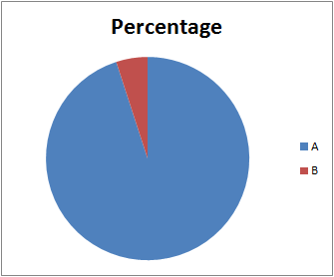
Introduction: Class-Imbalance

Slide 9
Introduction: Learning Classifier Systems
Evolutionary Algorithm as search mechanisms
efficient
Robust
complex
Genetics-Based Machine Learning

Slide 10
Motivation

Slide 11
Churn Prediction

Slide 12
Automated Loan Evaluation

Slide 13
Motivation
Imbalanced data
Plenty of irrelevant attributes (Over-fitting!)

Slide 14
Motivation
Design a Learning Classifier System that handles
Over-fitting
+
class-Imbalance
Jointly

Slide 15
Our Approach

Slide 16
Our Approach
Why our approach is different?
Addresses the over-fitting and class-imbalance problem jointly
Destructive approach with an intelligent deletion mechanism
Separate population for each class of a given problem and ensemble system for handling the class-imbalance
Rule post-processing step
Avoid multiple training phase with different parameter settings
Simple: few operators and parameters

Slide 17
Our Approach
2 major tasks
Rule Induction task
Classification task

Slide 18
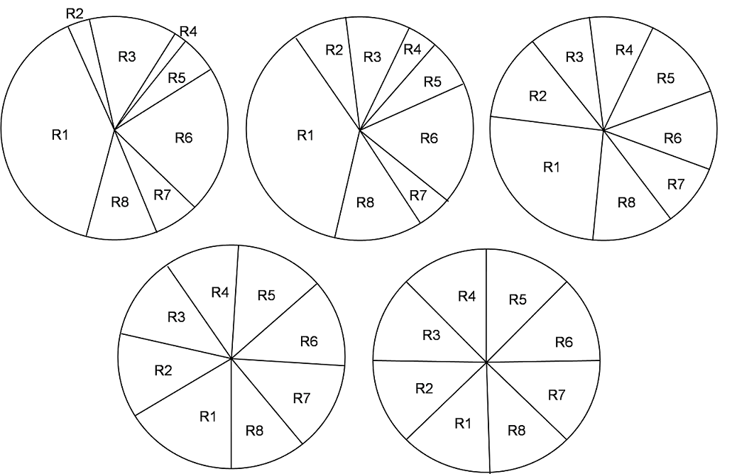
Our Approach: Rule Induction task

Slide 19
Our Approach: Rule Induction task
Rule Interestingness

Slide 20
Our Approach: Rule Induction task
Intelligent deletion
Initial deletion amount
Initial probabilities for attribute deletion

Slide 21
Our Approach: Rule Induction task
Intelligent deletion
Iterative update of deletion amount
Iterative update of probabilities for attribute deletion

Slide 22
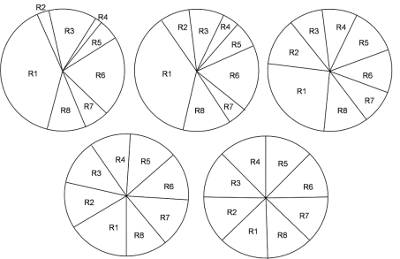
Our Approach: Rule Induction task
Calculate Attribute Interestingness
Consider a unprocessed class, i
Any class remaining ?
Output Selected Rules
Yes
No
Construct Population P_{i}
Recalculate Deletion Probabilities
Yes
Better solution found?
Select Rules from the best individual of P_{i}
No
Set Deletion probabilities
Apply Intelligent Deletion
Execute GA to optimize P_{i}

Slide 23
Our Approach: Classification task
Match against all selected rules
Assign the class with majority vote
Compute partial matches to resolve ties

Slide 24
Experimental studies

Slide 25
Experimental studies
Datasets from UCI machine learning repository
30 standard data-sets
33 imbalanced data-sets
Compared algorithms
20 evolutionary approaches
7 non-evolutionary approaches
Performance Measures
Accuracy
Cohen’s kappa
G-mean

Slide 26
Results

Slide 27
Results

Slide 28
Results

Slide 29
Results

Slide 30
Experimental studies: Results Box plot for G-mean to compare EDARIC and other evolutionary approaches

Slide 31
Experimental studies: Results Star plot for G-mean to compare EDARIC and other selected evolutionary approaches

Slide 32
Conclusion
New evolutionary approach based algorithm, EDARIC
Destructive approach
encounter over-fitting and class-imbalance simulataneously
Extensive simulation
Superiority of proposed method

Slide 34
Related Works

Slide 35
Related Works: Existing Classifier Models
Evolutionary Approaches
Non-evolutionary Approaches

Slide 36
Related Works: Existing Evolutionary Classifier Models
Michigan Approach
XCS
UCS
Pittsburgh Approach
GIL
Pitts-GIRLA
DMEL
GASSIST
OIGA
ILGA

Slide 37
Related Works: Existing Evolutionary Classifier Models
Iterative Rule Learning Approach
SIA
HIDER
Genetic Cooperative Competitive Learning Approach
CORE
OCEC
COGIN
Hybrid Evolutionary Decision Trees
DT-GA
Oblique-DT
TARGET

Slide 38
Related Works: Existing non-Evolutionary Classifier Models
CART
AQ
CN2
C4.5
C4.5-Rules
Ripper

Slide 39
Motivation
(Continued)

Slide 40
Motivation
Two popular LCS approach
Michigan
Pittsburgh

Slide 41
Motivation
Michigan Approach
Overfitting issue handled in
P. L. Lanzi. An analysis of generalization in the xcs classifier system. Evol. Comput., 7(2):125–149, June 1999.
S. W. Wilson, S. W. Wilson, G. Xcs, and C. System. Generalization in the xcs classifier system, 1998
Class-Imbalance issue handled in
A. Orriols-Puig and E. Bernad-Mansilla. Evolutionary rule-based systems for imbalanced data sets. Soft Computing, 13(3):213–225, 2009.
A. Orriols-Puig, E. Bernad´o-Mansilla, D. E. Goldberg, K. Sastry, and P. L. Lanzi. Facetwise analysis of xcs for problems with class imbalances. Trans. Evol. Comp, 13(5):1093–1119, Oct. 2009

Slide 42
Motivation
Pittsburgh Approach
Overfitting issue handled in
J. Bacardit and J. M. Garrell. Bloat control and generalization pressure using the minimum description length principle for a Pittsburgh approach learning classifier system. In Proceedings of the 2003-2005 international conference on Learning classifier systems, IWLCS’03-05, pages 59–79, Berlin, Heidelberg, 2007. Springer-Verlag.
J. Bacardit and N. Krasnogor. Performance and efficiency of memetic pittsburgh learning classifier systems. Evol. Comput., 17(3):307–342, Sept. 2009.
C. Z. Janikow. A knowledge-intensive genetic algorithm for supervised learning. Mach. Learn., 13(2-3):189–228, Nov. 1993.

Slide 43
Motivation
Pittsburgh Approach
Class-Imbalance issue handled in

Slide 44
Motivation
In all Learning Classifier Systems
Class-Imbalance and Over-fitting issue jointly handled in

Slide 45
Our Approach: Rule Induction task
Encoding
attributes a, b, c, d, e
class attribute is t.
Rule:
a
b
c
d
e
Encoding of a gene
a
b
c
d
e
a
b
c
d
e
Encoding of an individual/chromosome

Slide 46
Our Approach: Rule Induction task
Fitness Evaluation

Slide 47
Our Approach: Rule Induction task
Initialization
Multiple population
One population per class
Population of class i is denoted by P_{i}
To construct a chromosome of P_{i}
randomly pick m% of the training examples from the training set with class label i.
Here, m is a user defined parameter.

Slide 48
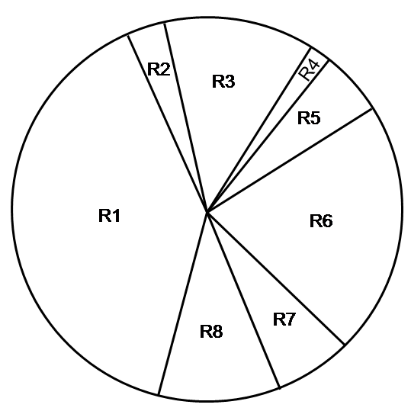
Our Approach: Rule Induction task
Selection
Parent selection
Survival selection

Slide 49
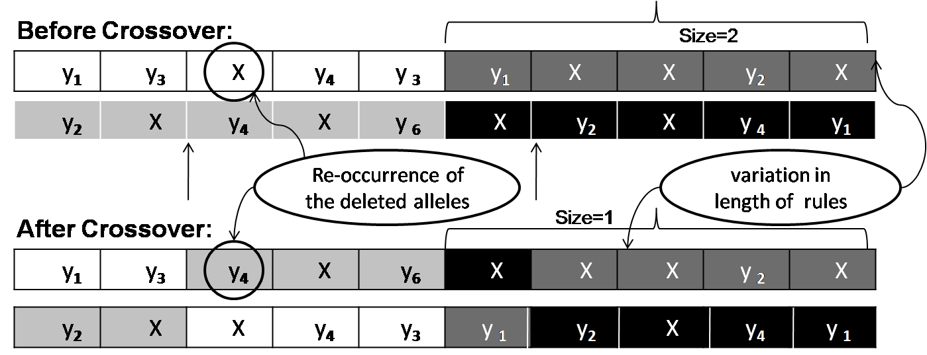
Our Approach: Rule Induction task
Crossover

Slide 50
Our Approach: Rule Induction task
Mutation
Before Mutation:
After Mutation:
Select an Allele
Select a Gene
1 | 3 | 2 | 4 | 3 | 1 | 2 | 3 | 2 | 5
1 | 3 | 2 | 4 | 3 | 1 | 5 | 3 | 2 | 5

Slide 51
Our Approach: Rule Induction task
Intelligent deletion
Initial stage of evolution
Delete less interesting attributes from rules
Large volume
Final stage of evolution
Delete more interesting attributes from rules
Small volume

Slide 52
Our Approach: Rule Induction task

Slide 53
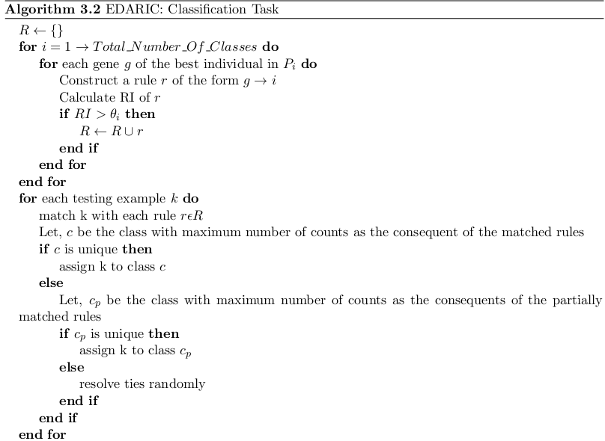
Our Approach: Classification task

Slide 54
Performance Measures

Slide 55
Experimental studies: Performance Measures
Classification rate (accuracy)
number of correct classifications relative to the total number of classifications.

Slide 56
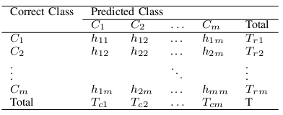
Experimental studies: Performance Measures
Cohen’s Kappa
Cohen’s kappa ranges from -1 to 1
-1 (total disagreement)
0 (random classification)
1 (perfect agreement)

Slide 57
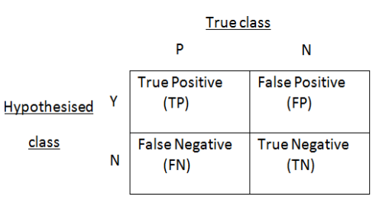
Experimental studies: Performance Measures
G-mean
Ranges from 0 to 1

Slide 58
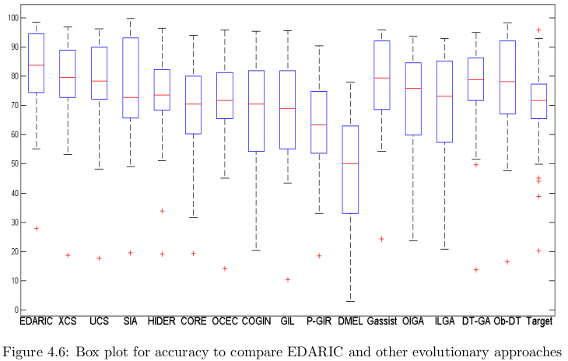
Experimental studies: Results Box plot for accuracy to compare EDARIC and other evolutionary approaches

Slide 59
Experimental studies: Results Star plot for Accuracy to compare EDARIC and other selected evolutionary approaches

Slide 60
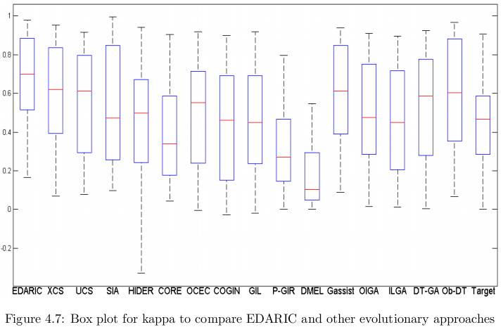
Experimental studies: Results Box plot for kappa to compare EDARIC and other evolutionary approaches

Slide 61
Experimental studies: Results
Star plot for Kappa to compare EDARIC and other selected evolutionary approaches

Slide 62
Data-sets

Slide 64
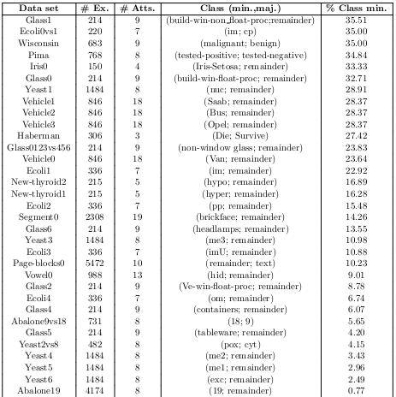

Slide 65
Results

Slide 66
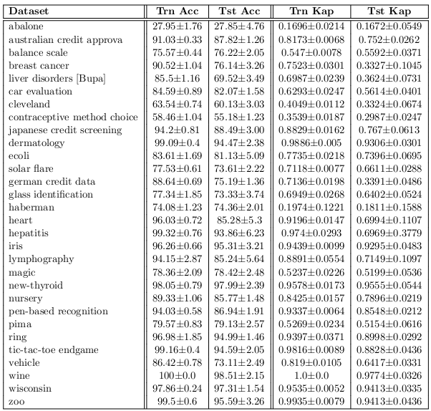
Experimental studies: Results Accuracy and Kappa results for EDARIC on the standard data-sets

Slide 67
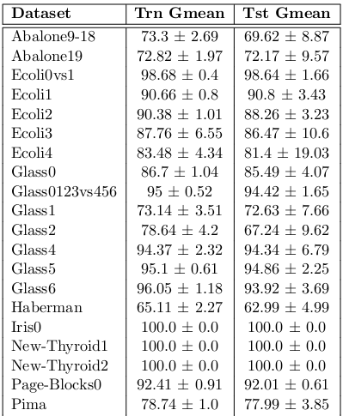
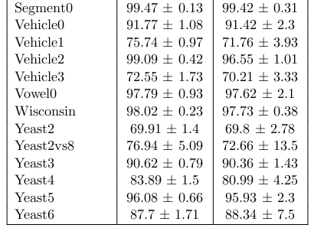
Experimental studies: Results Gmean results for EDARIC on the imbalanced data-sets

Slide 68
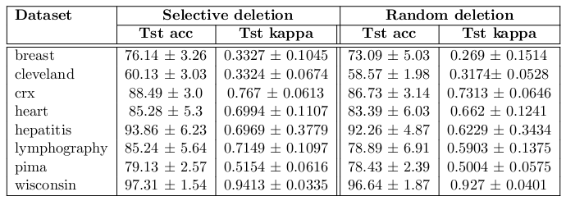
Experimental studies: Results Accuracy and Kappa results for EDARIC with selective and random deletion on the standard data-sets

Slide 69
Experimental studies: Results G-mean results for EDARIC with selective and random deletion on the imbalanced data-sets

Slide 70
Experimental studies: Results Wilcoxon signed rank test summary between EDARIC with selective deletion and random deletion

Slide 71
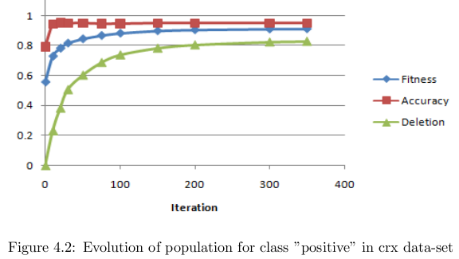
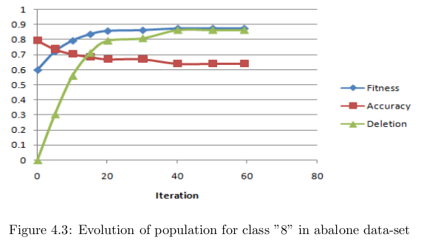
Experimental studies: Results

Slide 72
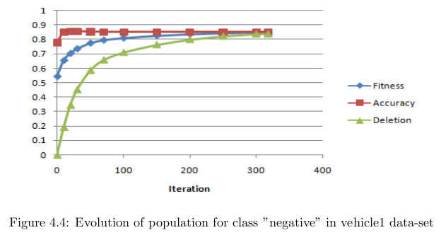
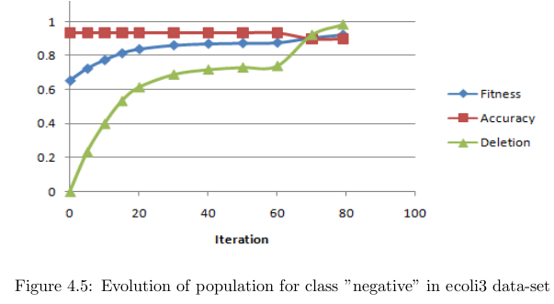
Experimental studies: Results

Slide 73
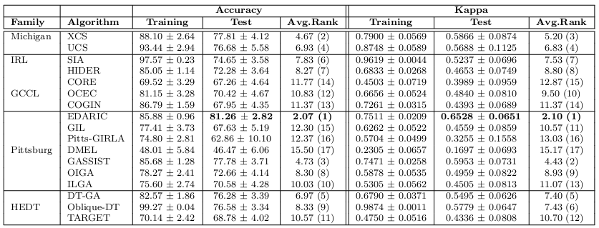
Experimental studies: Results Comparison of accuracy and kappa results of EDARIC and state-of-the-art evolutionary approaches for standard data-sets

Slide 74
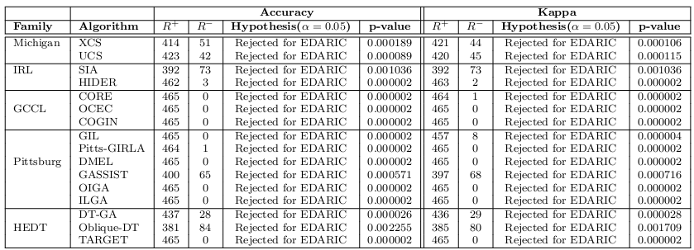
Experimental studies: Results Wilcoxon signed rank test summary between EDARIC and other evolutionary approaches for standard data-sets

Slide 75
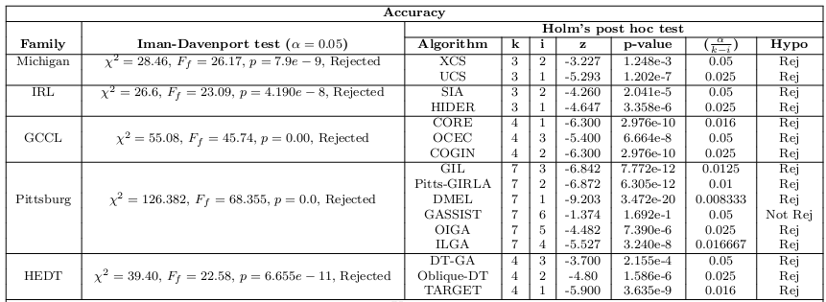
Experimental studies: Results Iman Davenport test and Holm's post hoc test summary between EDARIC and different families of evolutionary approaches for standard data-sets with α= 0:05

Slide 76
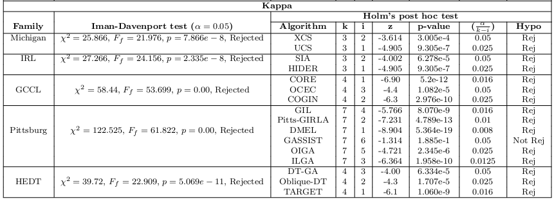
Experimental studies: Results Iman Davenport test and Holm's post hoc test summary between EDARIC and different families of evolutionary approaches for standard data-sets with α= 0:05

Slide 77
Experimental studies: Results Comparison of g-mean results of EDARIC and state-of-the-art evolutionary approaches for imbalanced data-sets

Slide 78
Experimental studies: Results Wilcoxon signed rank test summary between EDARIC and other evolutionary approaches for imbalanced data-sets

Slide 79
Experimental studies: Results Iman Davenport test and Holm's post hoc test summary between EDARIC and di erent families of evolutionary approaches for imbalanced data-sets with α= 0:05

Slide 80
Experimental studies: Results Comparison of accuracy and kappa results of EDARIC, family representative evolutionary approaches and state-of-the-art non-evolutionary approaches for standard data-sets

Slide 81
Experimental studies: Results Box plot for accuracy to compare EDARIC and other evolutionary and non-evolutionary approaches

Slide 82
Experimental studies: Results Star plot for Accuracy to compare EDARIC and other selected evolutionary and non-evolutionary approaches

Slide 83
Experimental studies: Results Box plot for kappa to compare EDARIC and other evolutionary and non-evolutionary approaches

Slide 84
Experimental studies: Results Star plot for Kappa to compare EDARIC and other selected evolutionary and non-evolutionary approaches

Slide 85
Experimental studies: Results Wilcoxon signed rank test summary between EDARIC and state-of-the-art non-evolutionary approaches for standard data-sets

Slide 86
Experimental studies: Results Iman Davenport test and Holm's post hoc test summary between EDARIC and state-of-the-art non-evolutionary approaches for standard data-sets

Slide 87
Experimental studies: Results Comparison of g-mean results of EDARIC, family representatives of evolutionary approaches and state-of-the-art non-evolutionary algorithms for imbalanced data-sets

Slide 88
Experimental studies: Results Box plot for G-mean to compare EDARIC and other evolutionary and non-evolutionary approaches

Slide 89
Experimental studies: Results Star plot for Kappa to compare EDARIC and other selected evolutionary and non-evolutionary approaches

Slide 90
Experimental studies: Results
Wilcoxon signed rank test summary between EDARIC and state-of-the-art non-evolutionary approaches for imbalanced data-sets

Slide 91
Experimental studies: Results Iman Davenport test and Holm's post hoc test summary between EDARIC and state-of-the-art non-evolutionary approaches for imbalanced data-sets

Slide 92
Experimental studies: Results Comparison ofGmean² results of EDARIC, Orriol's customized versions of XCS and UCS

Slide 93
Experimental studies: Results Pairwise Wilcoxon-Signed-Rank test summary between EDARIC and each of Orriol‘s customized versions of XCS, UCS

Slide 94
Experimental studies: Results Iman Davenport test and Holm's post hoc test summary among EDARIC, Orriol's cus-tomized versions of XCS and UCS

Slide 95
Experimental studies: Results Comparison of accuracy results of EDARIC, PART and SS-LCS

Slide 96
Experimental studies: Results Pairwise Wilcoxon-Signed-Rank test summary between EDARIC and each of PART, SS-LCS

Slide 97
Experimental studies: Results Iman Davenport test and Holm's post hoc test summary among EDARIC, PART and SS-LCS

Slide 98
References

Slide 99
References

Slide 100
References

Slide 101
References

Slide 102
References

Slide 103
References

Slide 104
References

Slide 105
References

Slide 106
References

Slide 107
References

Slide 108
References

Slide 109
References

Slide 110
References

Slide 111
References

Slide 112
References

